Slide 1

Big Data Analytics
PATTERN BASED CHANGE DETECTION ALGORITHMS APPLIED TO CLIMATE DATA
AY 2022/2023
Lorenzo Capocchiano
Domenico Narracci

Slide 2
Big Data Analytics
Complex process of big data examination to discover new information useful for organizations and public administrations

Slide 3
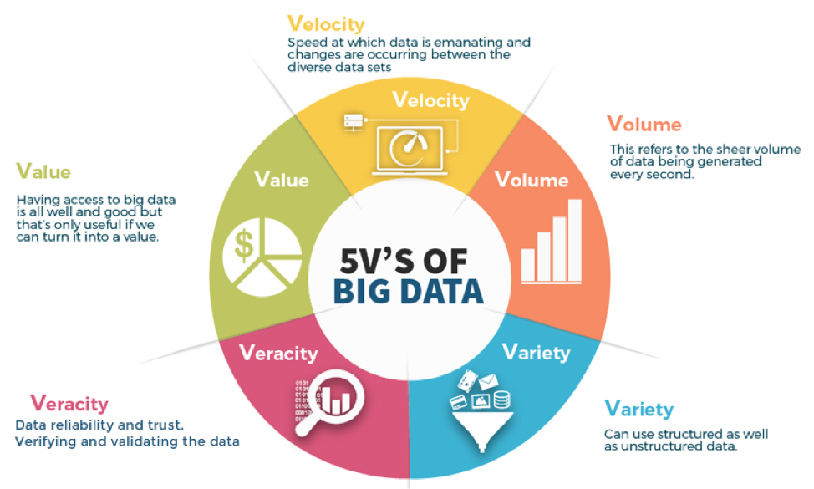

Slide 4
Objectives
Retrieve and analyze climate data over last twenty years
Discover pattern starting from data
Detect how and to what extent climate has been changed over the time

Slide 5

Which data
Global Historical Climate Network includes daily land surface observations from around the world
The dataset includes observations from World Meteorological Organization, Cooperative, and CoCoRaHS networks.

Slide 6
Temporal Data Analysis

